Slide 1
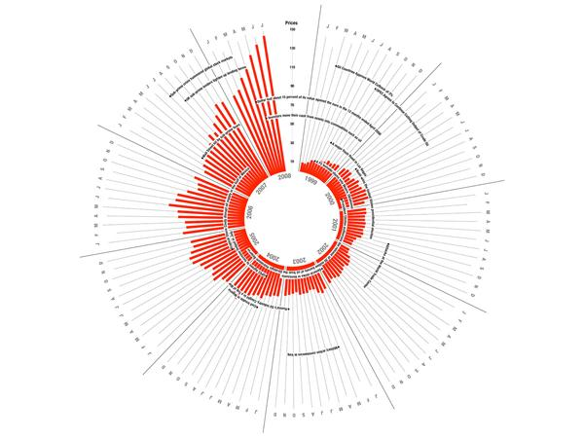
Data Visualization Composition
MSc in Data Analytics
Notes:
Most content in this set of lecture notes taken from Kirk (2016).

Slide 2
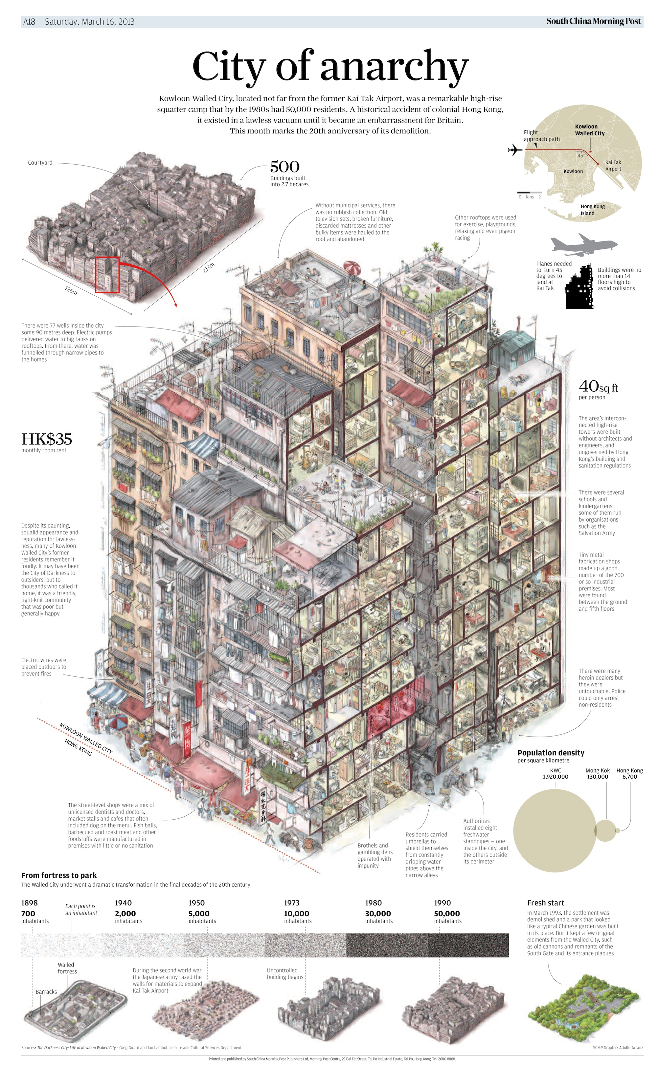
Kowloon Walled City
Clear visual hierarchy across design
There is a primary focal point of the main subject “cutaway” illustration in the centre with a small thumbnail for orientation
At the bottom there are small supplementary illustrations to provide further information
It is clear through their relative placement at the bottom of the page, and their more diminutive stature, that they are somewhat incidental import compared with the main detail in the centre
Image Source: http://lasombra.blogs.com/la_sombra_del_asno/2013/03/kwc.html
Notes:
http://lasombra.blogs.com/la_sombra_del_asno/2013/03/kwc.html

Slide 3
Composition
Making careful decisions about the physical attributes of, and the relationship between, every visual property to ensure the optimum readability and the meaning of the overall, cohesive project
No longer about what elements will be included in data visualizations, but how they will appear
Critical component of any design discipline

Slide 4
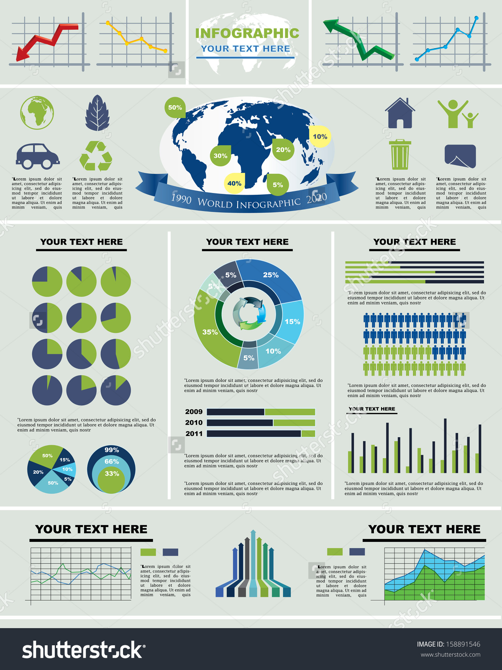
Assets occupy space!
Charts
Interactive controls
Annotations
What is the best way to use space
Position
Size
Shape
Image sourced from Shutterstock.
Notes:
Shutterstock image (and others at link) show how some infographics are composed.

Slide 5
Features of Composition (Kirk, 2016)
Project composition
Defining the layout and hierarchy of the entire visualization project
Chart composition
Defining the shape, size and layout choices for all compositions within your charts

Slide 6

Project Composition
Questions
Where will you put all assets?
What size will it be and why?
How will the hierarchy (across views) and sequencing (within a view) best fit the space you have to work in?
How will you convey the relative importance and provide a connected narrative where necessary?
Image source: https://expresswriters.com/wp-content/uploads/2013/08/common-sense-copywriting-1000x360.jpg
Notes:
So much about composition thinking is rooted in common sense and involves a process of iteration towards what feels like an optimum layout.

Slide 7
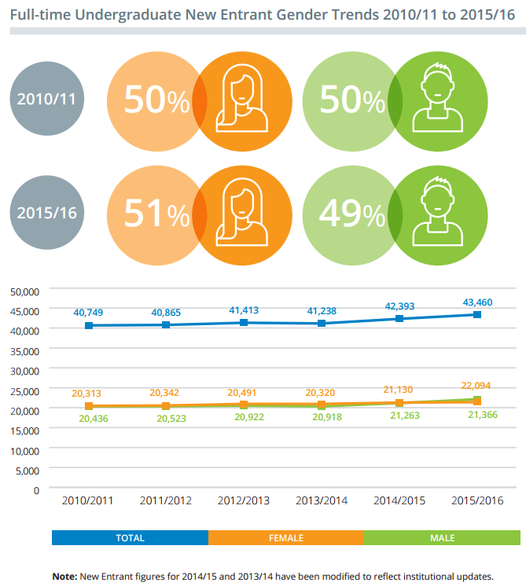
Established conventions
Titles
First or at top
Introductions
Offer early
Footnotes and credits
Less important
Main features
Show first (or build up to)
Exploit initial attention from audience
Image source: HEA Key Facts and Figures 2015/16
Notes:
Page 2: http://hea.ie/sites/default/files/hea-201516-key-factsfigures.pdf

Slide 8
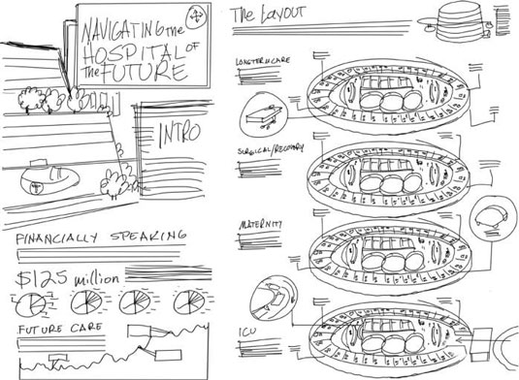
Wireframing and Storyboarding
Wireframing
Sketching potential layout and size of all the major contents of your design thinking
Single page view
Add description for interactive controls
Low fidelity sketched concepts
Capture with moderate precision the essence of your early thinking
Iteration
Image source: http://www.dummies.com/programming/big-data/big-data-visualization/wireframe-planning-map-and-block-your-infographic/

Slide 9
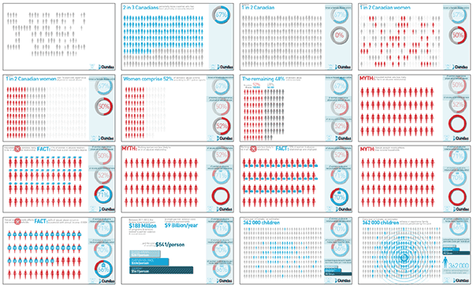
Wireframing and Storyboarding
Storyboarding
Undertake with wireframing
Multiple pages/different views
High-level feel for:
Overall architecture
Content
Navigation
Sequencing
Good for:
Discrete sequences in reports
Presentation slides/video
Multi-faceted interactive
Gender Violence in Canada Storyboard
Image source: http://www.adiemarg.com/work_gender_violence_canada.html
See also on YouTube: https://www.youtube.com/watch?v=Np6bRGzsO9U

Slide 10
Chart Composition
Detailed spatial matters local to each chart
Optimize legibility and meaning
Many different components:
Chart size
Chart Scales
Chart orientation
Chart value sorting

Slide 11
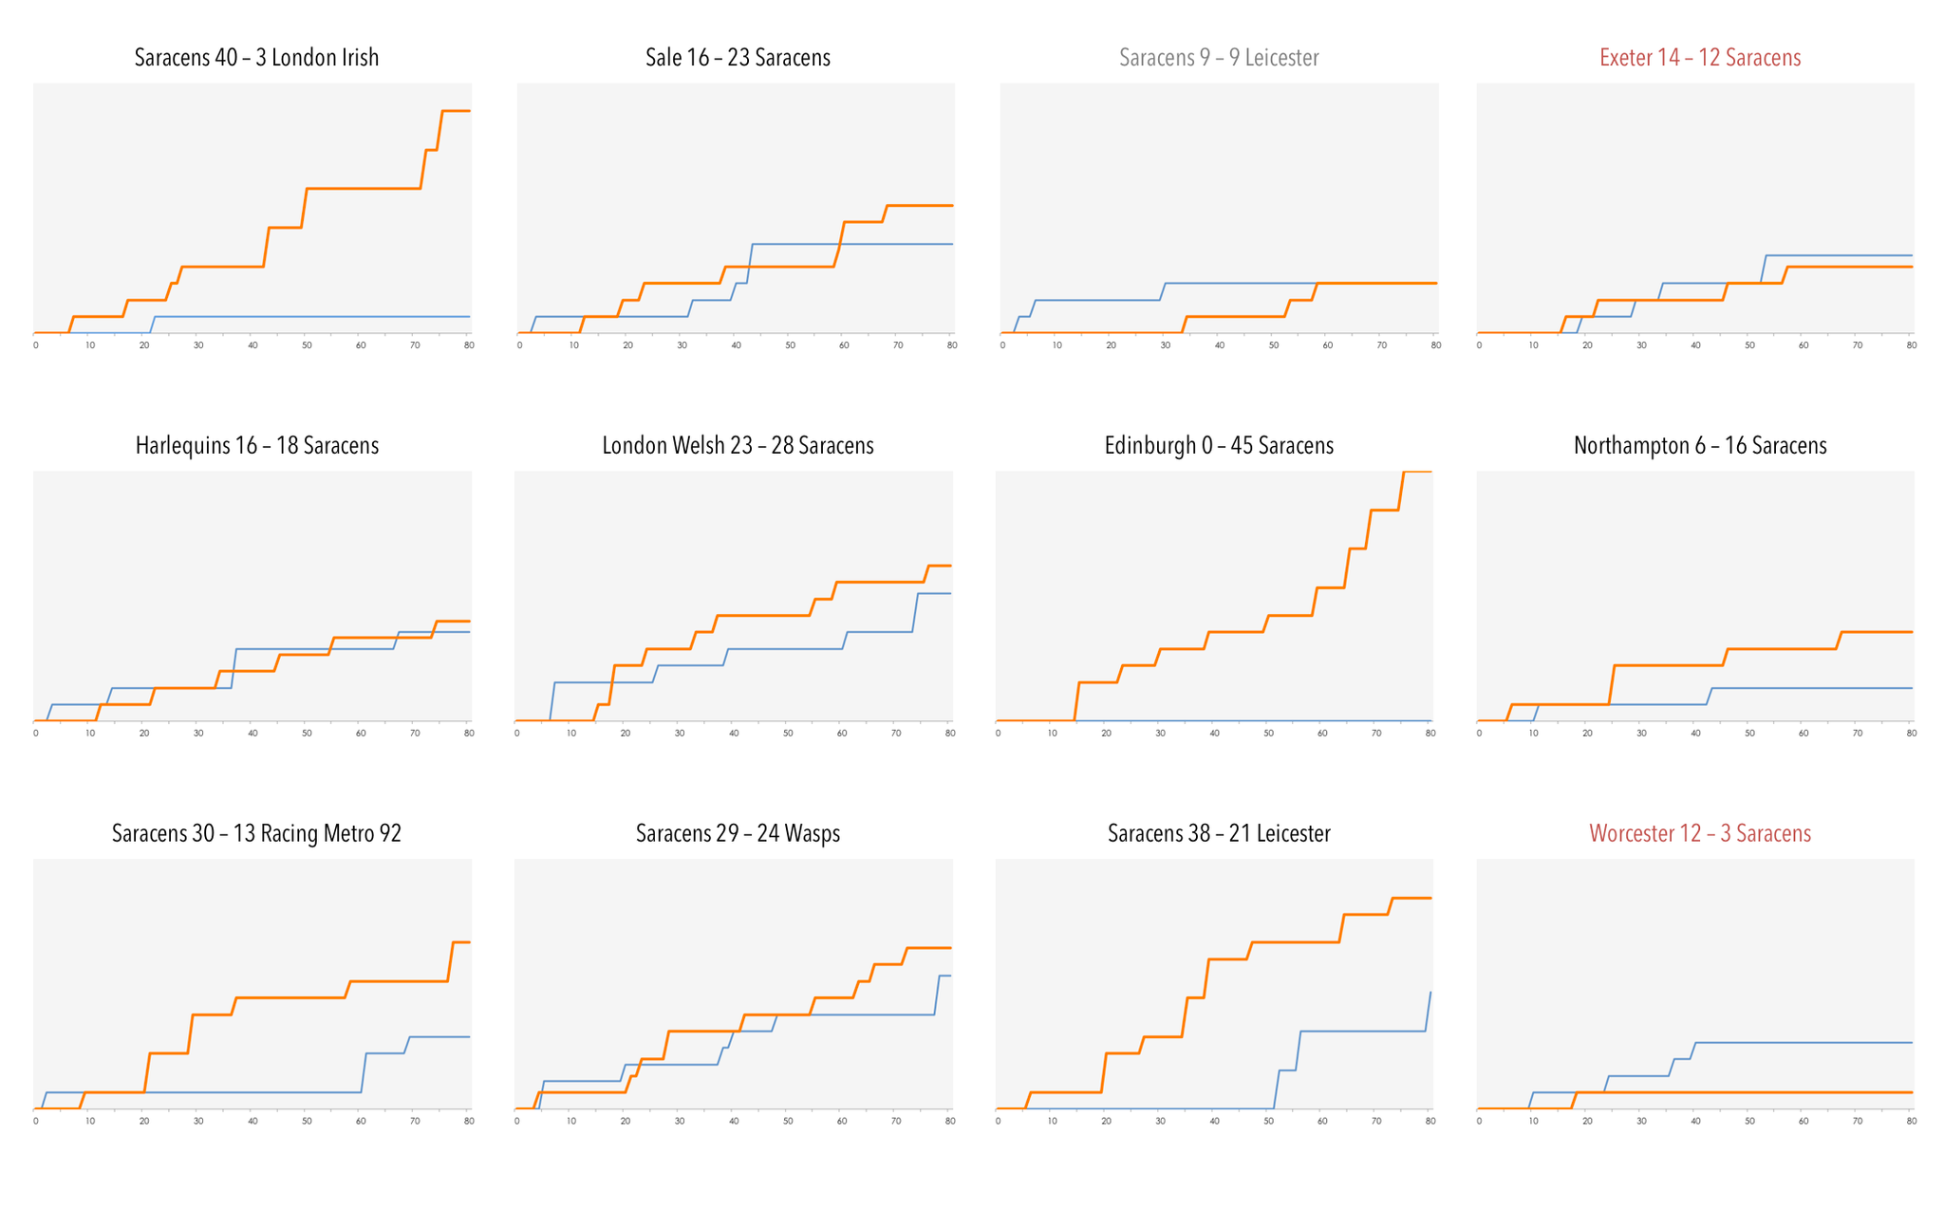
Chart Size
Do not be afraid to shrink charts!
Small multiples technique
Same analysis for multiple categories/points in time
Viewers can efficiently observe overall patterns as well as perform a more detailed inspection
Saracens Rugby Club match pattern
Main obstacle
Shrinking of text
Notes:
Saracens.
Single view of Saracens’ match patterns across first 12 matches of a season. Each line chart panel portrays the cumulative scoring for the competing teams across the 80 minutes of a match. The 12 match panels are arranged in chronological order, from top left to bottom right, based on the date of the match.

Slide 12
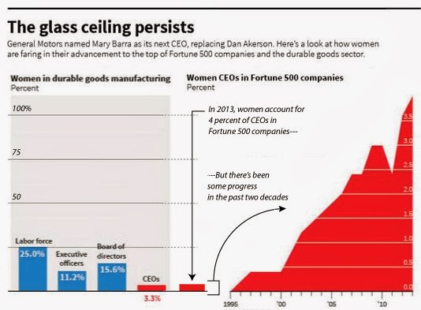
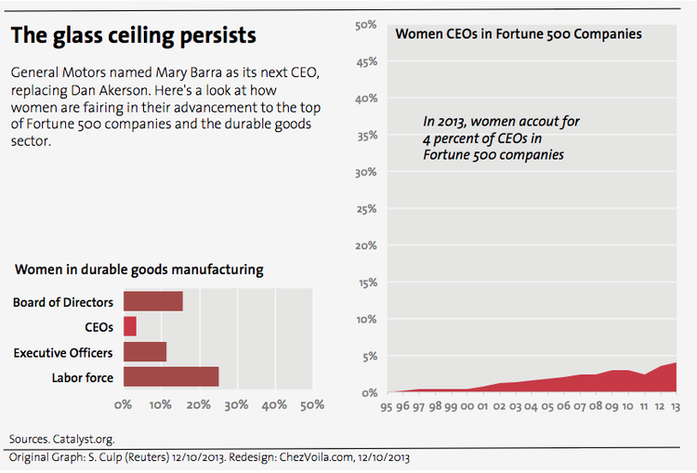
Chart Scales
Must be meaningful
Astute choices around the maximum value ranges
Suitable intervals for labelling and gridline guides
vs
Source: https://www.chezvoila.com/blog/glass-ceiling
Notes:
From: Gagnon (2013), “Looking for the right scale” (https://www.chezvoila.com/blog/glass-ceiling)
My main design issue was that the data point in the middle [of graphic on left above] — Women CEOs in Fortune 500 companies — relies on the left for its definition and the right for its scale, which is likely too unusual for the average reader to notice. I know I was fooled by it. Cairo explained that he didn't have the time to create a separate scale, but sticked to his guns that the scale should maximize the visibility of the rise. I think it exaggerates the rise and we need to show its true scale, in line with the title of the graphs. I proposed using a 50% scale and Cairo suggested that someone test this approach.
This redesign [graphic on right above] is more radical than the previous two. I didn't stick to the original look and feel for lack of time, but mostly I wanted to test a few things.
The scale is 50% because that's the theoretical target in a gender-neutral world. This happens to be a compromise between showing a scale that fits the data (4-5%) and one that shows the entire realm of possibilities (100%).
The graph on the "share of women across levels" is now horizontal because it represents a hierarchy. One wants to see as many women "at the top" as men. This now recreates this sense that there is a top and clearly shows that the biggest issue is at the CEO level. Of course, the Board of Directors are above CEOs and other executives, as they elect them.
The colors are two shades of red to diminish the distinction between the CEOs and the rest. The color coding in Reuters' original was meant to link "women CEOs" across the graph, but it so links two different data sets (Fortune 500 vs. durable goods companies). I felt there is more in common between "women" in the two charts than warrants the use of a different color. My initial reaction was to look against what women were compared, until I realized they weren't. Still, to preserve the link between the two charts (CEOs), I used a lighter shade of red in both cases.
I dared to remove the exact numbers, though increasing the level of precision of the gridline, in part to draw the attention to the data made visible by the graphs and in part because Excel just wouldn't do what I wanted and it was getting late, I'm afraid.
May this imperfect redesign contribute to the discussion about proper scale. In any case, it's been great to have so many exchanges about women CEOs. The data suggests that we need more.

Slide 13
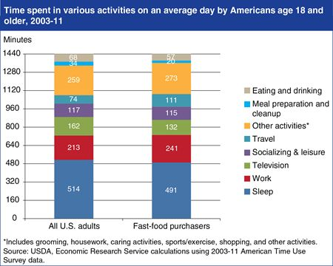
Poor Chart Scale Design
1,440 minutes in a day
Horizontal gridlines displayed at 160 minute intervals
Meaningless quantity of time
60 minutes more logical
Image source: https://www.pinterest.com/pin/348184614916399894/
Notes:
Fast-food purchasers report more demands on their time.
Original referred to on page 297 of Kirk book no longer available. Above found on Pinterest.

Slide 14
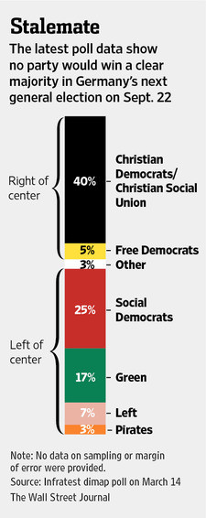
Chart Orientation
Primary concern
Legibility of labels along the axis
Avoid label clutter on x-axis
Orientation 45 degrees or 90 degrees?
Change orientation of entire chart
“Stalemate” – a missed opportunity to display a political axis of the Left and Right through using a landscape rather than portrait layout?
Image source: http://twitpic.com/ccfovg

Slide 15
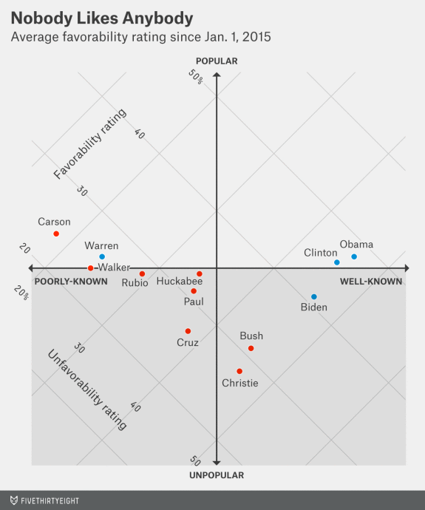
Quadrants
Image rotates the scatter plot by 45 degrees and then overlays a 2 x 2 grid which helps to guide the viewer’s interpretation by making it easier to observe which values are located in each quadrant
Also used to emphasize distinction between location in the top and bottom halves of the chart along the axis or popularity (essentially the primary focus of the analyst)
Image source: https://fivethirtyeight.com/datalab/kasich-could-be-the-gops-moderate-backstop/

Slide 16
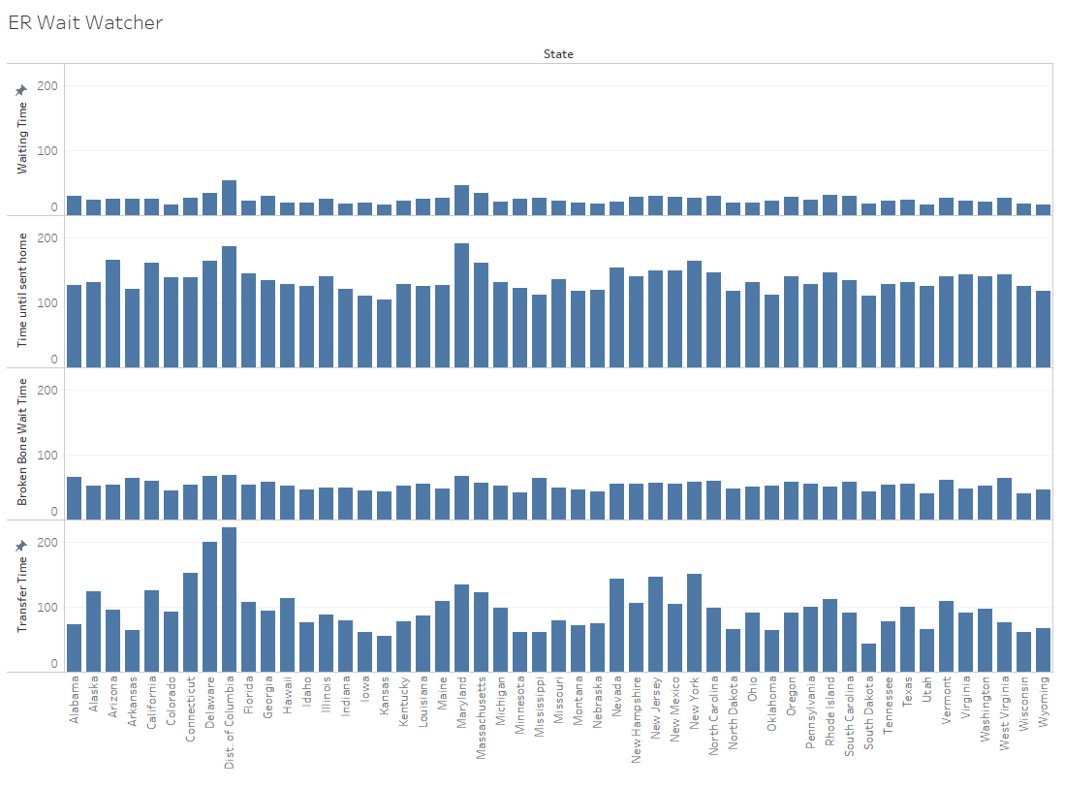
Chart Value Sorting
Sorting content within a chart is important for helping viewers to find and compare quickly the most relevant content
Short Exercise
ER Wait Times Data (Moodle)
Tableau and/or Excel
Notes:
About alphabetical sorting as a “diplomatic” option should you not wish to imply any ranking significance that would be displayed when sorting by any other dimension.

Slide 17
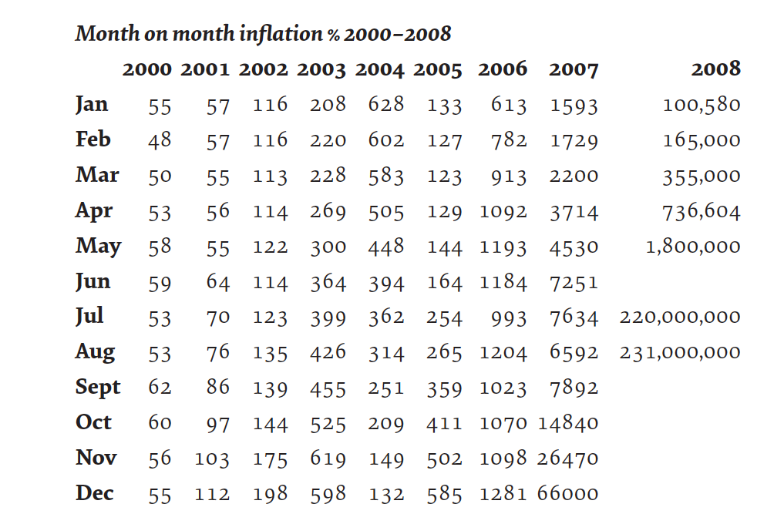
Influencing Factors and Considerations
Specific factors to keep in mind
Format
Data examination
Spatial consequence
Angles
Chart type choice
Different charts have different spatial consequences
See chart selection tool in Lecture #2
Table Source: https://www.dropbox.com/s/sjgee0emi02h4lk/10.15.TableWidth.png?dl=0
Notes:
Audacity of Graham van de Ruit showing Zimbabwe’s rate of inflation.
Includes incredibly diverse values.
Even though it is in tabular form, there is a strong visual impact create by allowing the sheer spatial consequence of the exceptional mid 2008 numbers to cause awkward widening of the final column.
More effective tan a chart?

Slide 18
Good Design (Andy Kirk, 2016)
The Three Principles of Good Visualization Design
Principle 1
Good data visualization is TRUSTWORTHY
Principle 2
Good data visualization is ACCESSIBLE
Principle 3
Good data visualization is ELEGANT
Notes:
This slide is also in Lecture 3 and 8.
Is my visualization design good visual design?

Slide 19
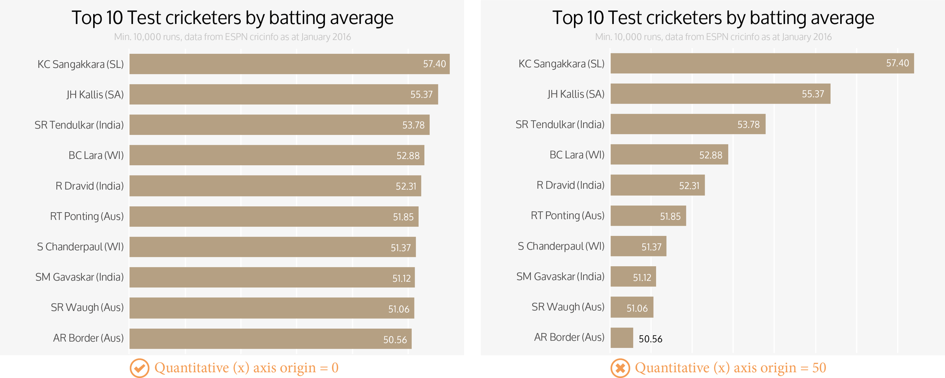
Trustworthy
Principle 1
Good data visualization is TRUSTWORTHY
Decisions about chart scales concern:
Maximum
Minimum
Interval choices
Ensure integrity as well as optimize readability
“Origin” needs to be zero
Show
True size
Full size
Image source: https://www.dropbox.com/s/hmnwrapkrl7leyy/10.17.Truncation.png?dl=0
Notes:
Note high relative differences in chart 2, when in fact the differences are small.

Slide 20
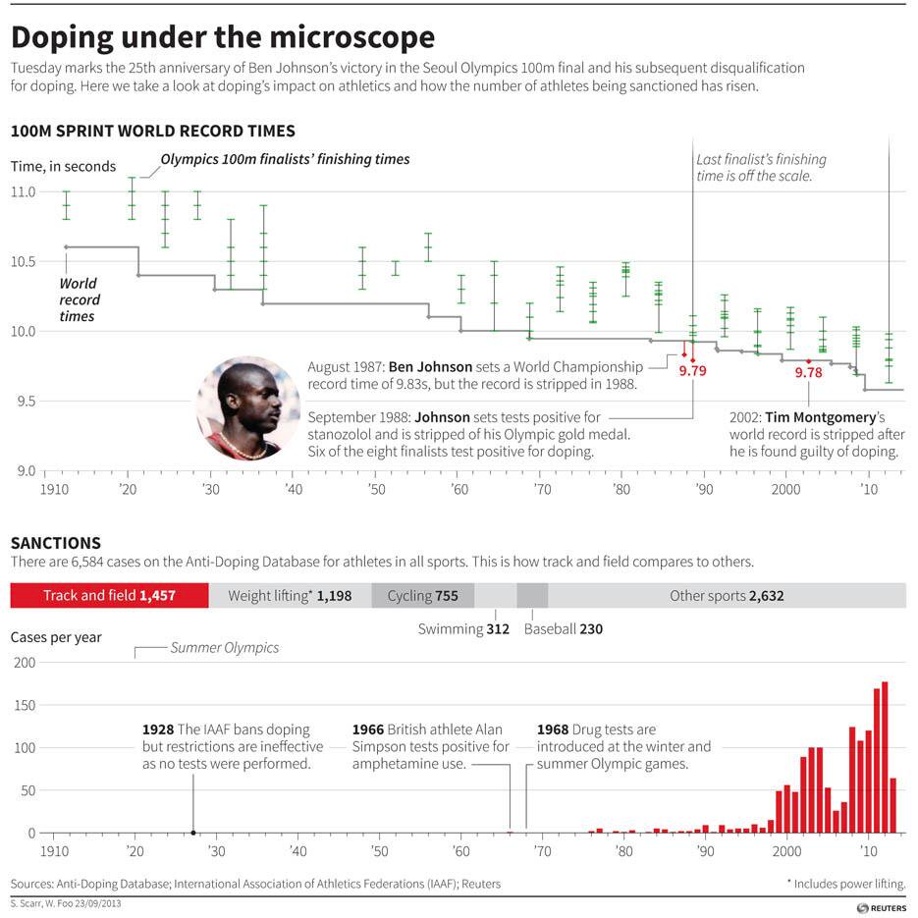
Trustworthy
Principle 1
Good data visualization is TRUSTWORTHY
Exceptions to “Origin” rule:
100m record times
Will anyone ever run 100m in zero seconds?
Image source: Twitter.
Notes:
Note high relative differences in chart 2, when in fact the differences are small.

Slide 21

Accessible
Principle 2
Good data visualization is ACCESSIBLE
Good design is unobtrusive
Avoid flicking between pages or interactively generated views
Viewers have to try to store one view in their mind
Mentally compare that against live view
Too hard and too likely to fail
Direct comparison?
Proximity
Alignment
Image source: http://cforapidfire.typepad.com/cfo-rapid-fire/2012/06/we-are-drowning-in-data-toss-us-an-analytic-life-preserver.html
Notes:
All due to weak performance of brain’s working memory

Slide 22
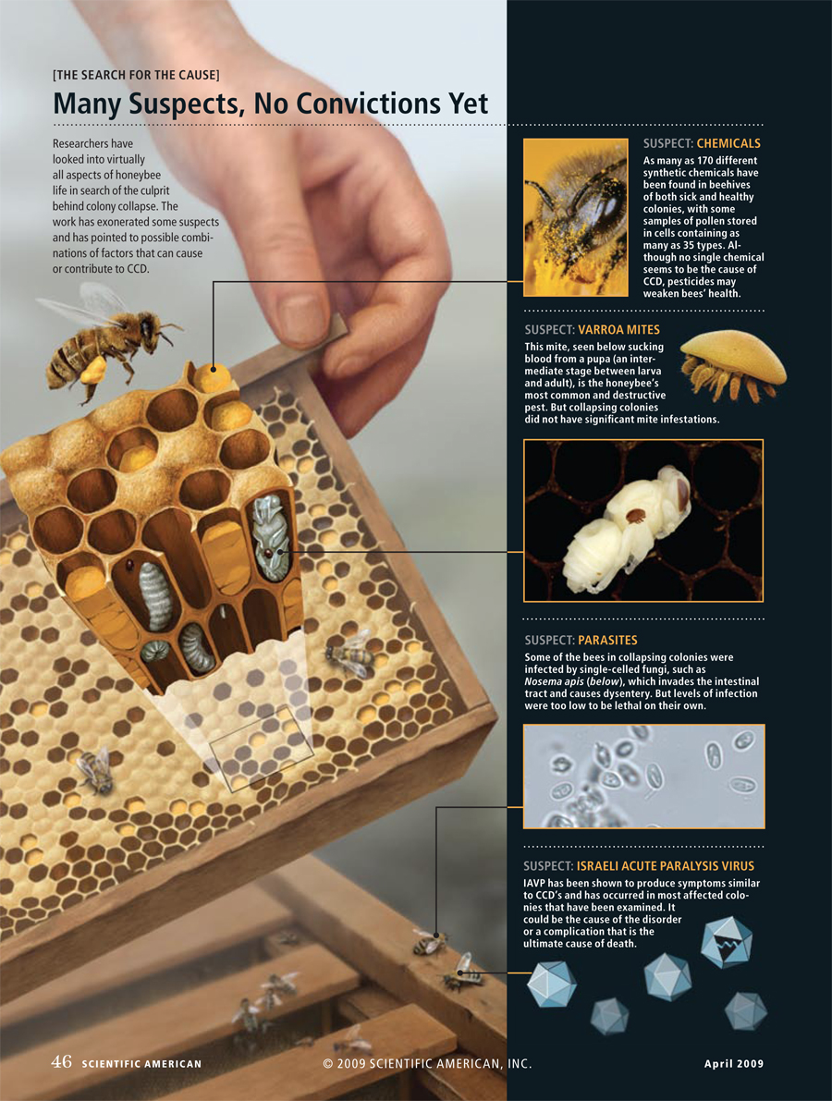

Elegant
Principle 3
Good data visualization is ELEGANT
“When it comes to data visualizations, I'm obsessed with alignments. Sloppy label placement on final files causes my confidence in the designer to flag. What other details haven't been given full attention? Has the data been handled sloppily as well? Not to mention, I then have to then spend more time cleaning up the files and preparing them for press, during the busiest time of the deadline cycle — as the full issue is barreling towards transmittal to the printer.
On the flip side, clean, layered and logically built final files are a thing of beauty….and my confidence in the designer, and their attention to detail, soars.”
@ChristiansenJen
Image source: jenchristiansen.com
Notes:
Taken from “SIX QUESTIONS WITH… JEN CHRISTIANSEN”
http://www.visualisingdata.com/2016/04/six-questions-jen-christiansen/
Image from: http://jenchristiansen.com/?p=17
Colony Collapse Disorder ROLE: illustration and page design; PRODUCT: “Saving the Honeybee,” By Diana Cox-Foster and Dennis VanEngelsdorp, Scientific American, April 2009; © Scientific American; (associated photos from top to bottom: Heidi and Hans-Jurgen Koch, Minden Pictures; Andrew Syred, Photo Researchers, Inc.; Central Science Laboratory, Photo Researchers, Inc.; Courtesy of Barton Smith, Jr. USDA Bee Research Laboratory)

Slide 23
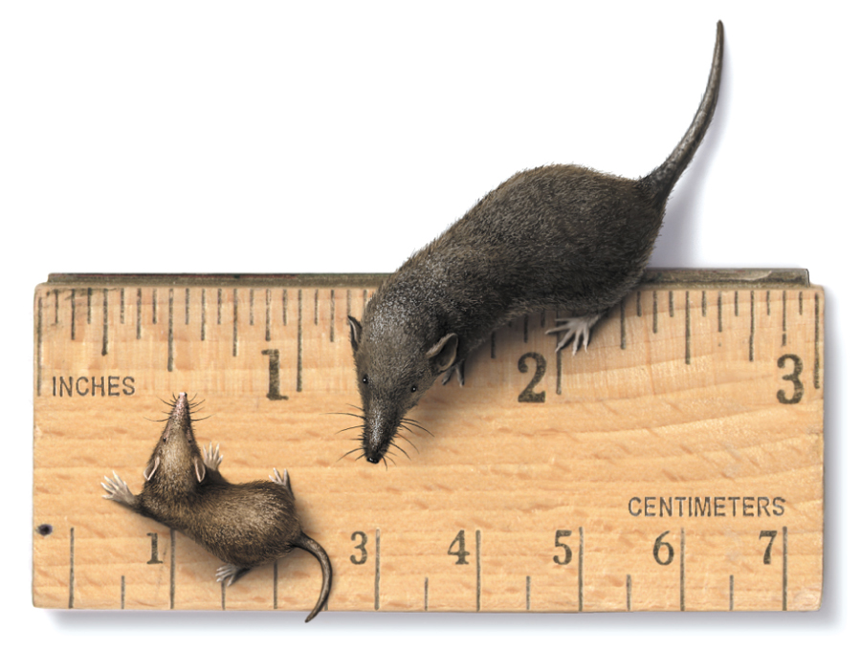
Elegant
Principle 3
Good data visualization is ELEGANT
Unity
Any object in space creates a relationship with everything else in the display
Flow of content should feel logical and meaningful
Thoroughness/Care
Precision positioning
Aim to “achieve pixel-perfect accuracy in the position and size of every single property” (Kirk, 2016)
Commit to precision
Image source: jenchristiansen.com
Notes:
Image from: http://jenchristiansen.com/?p=17
Batodonoides vanhouteni A reconstruction of the smallest known non-flying mammal (left), with a modern Etruscan shrew (right) for scale; illustration © National Geographic

Slide 24
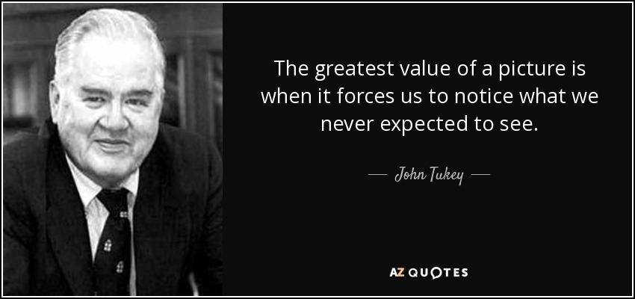
The End
Image source: http://www.azquotes.com/quote/593304

